Slide 1
Lecture 8 More complex graphics
Trevor A. Branch
FISH 552 Introduction to R

Slide 2
Some great plots from homework 2
(Thank you to Peter Kuriyama for grading the homeworks and compiling the plots.)

Slide 3
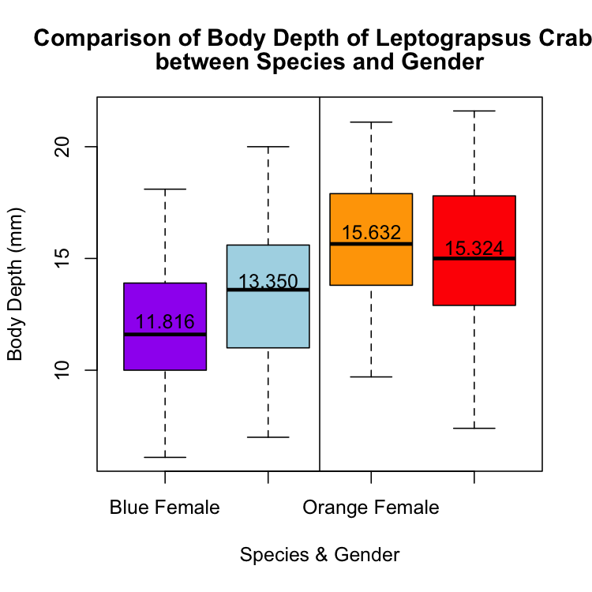
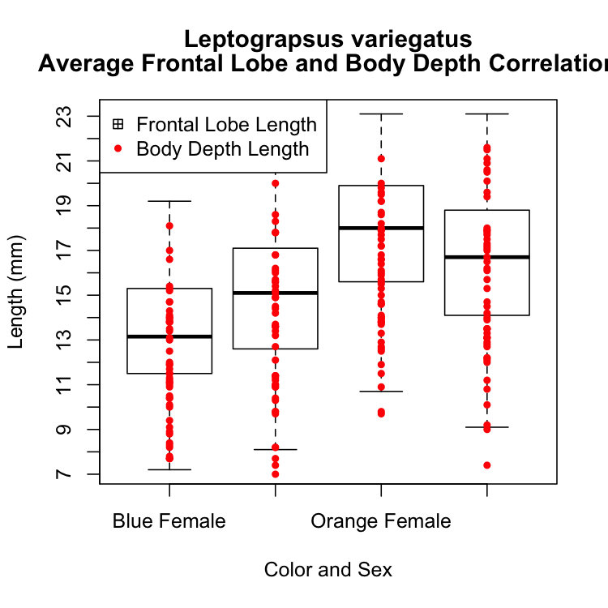
Box plots
Jennifer Ma
Erika Sutherland

Slide 4
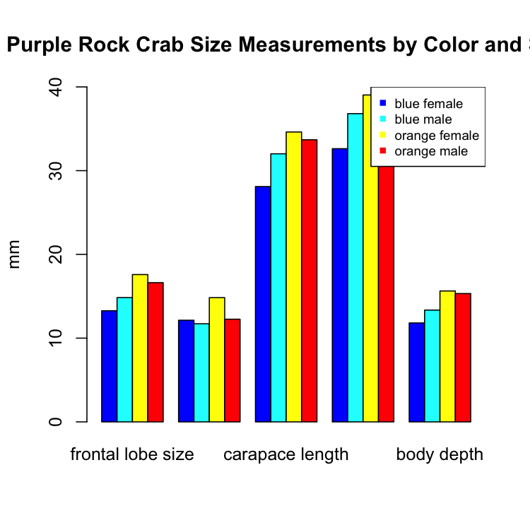
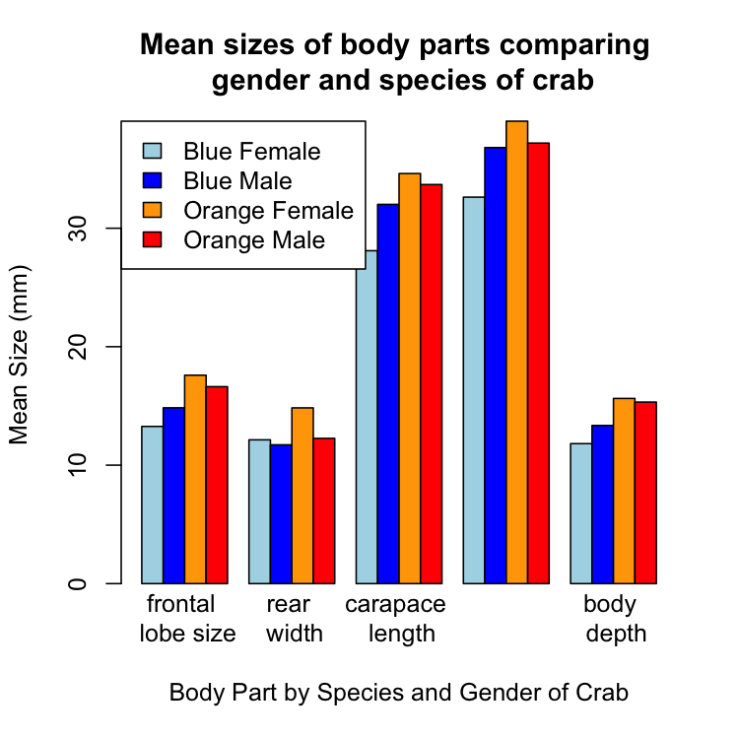
Bar plots
Lauren Wiesebron
Alison Fohner

Slide 5
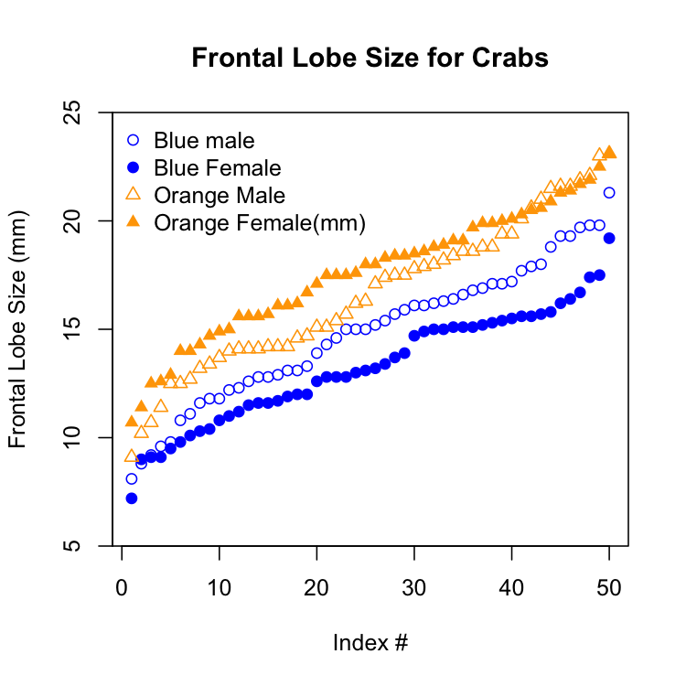
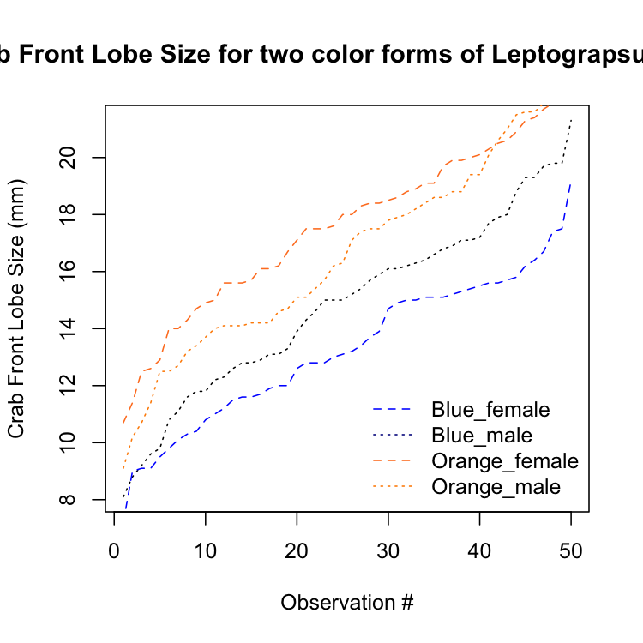
Lines and points
Se-Yeun Lee
Emilio Vilanova

Slide 6
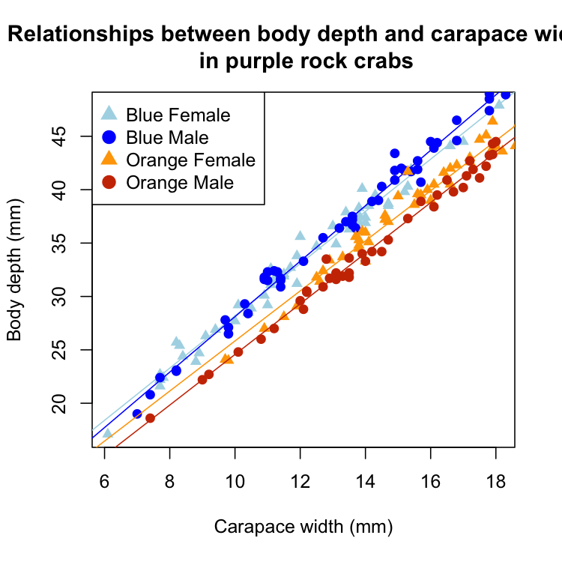
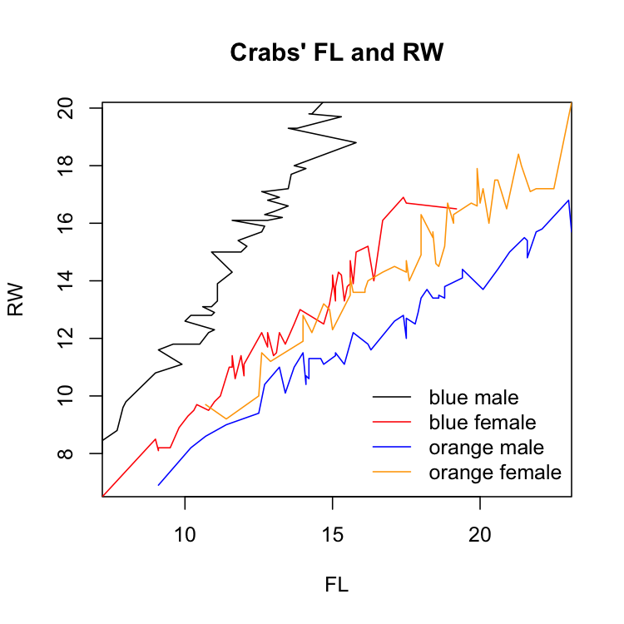
Correlations
Mike Tillotson
Ziyi Lu

Slide 7
Aims
To explore more of the options in R contained in par
Create more informative plots
Layouts for multiple plots
Boxplots
Barplots

Slide 8
Readings
Wainer H (1984) How to display data badly. The American Statistician 38:137-147
http://www.jstor.org/stable/2683253
Tufte ER (2001) The visual display of quantitative information. Second edition. Graphics Press, Cheshire, Connecticut
FISH 554 Beautiful Graphics in R (lectures, etc. online)
https://catalyst.uw.edu/workspace/tbranch/24589/223427

Slide 9
Possum data
Possum data come from the DAAG package
Download from Canvas: Data files\possum.csv
> possum <- read.csv(file="Data\\possum.csv")
> head(possum,n=3)
X case site Pop sex age hdlngth skullw totlngth
1 C3 1 1 Vic m 8 94.1 60.4 89.0
2 C5 2 1 Vic f 6 92.5 57.6 91.5
3 C10 3 1 Vic f 6 94.0 60.0 95.5
taill footlgth earconch eye chest belly
1 36.0 74.5 54.5 15.2 28.0 36
2 36.5 72.5 51.2 16.0 28.5 33
3 39.0 75.4 51.9 15.5 30.0 34

Slide 10
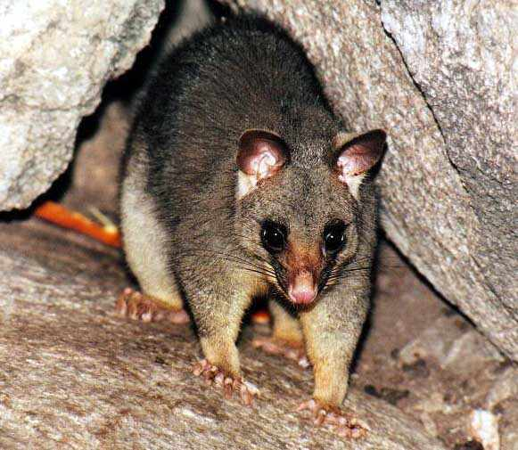
Possum data
case: observation number
site: one of seven locations where possums were trapped
Pop: a factor which classifies the sites as Vic Victoria, other New South Wales or Queensland
sex: a factor with levels f female, m male
age: age
hdlngth: head length
skullw: skull width
totlngth: total length
taill: tail length
footlgth: foot length
earconch: ear conch length
eye: distance from medial canthus to
lateral canthus of right eye
chest: chest girth (in cm)
belly: belly girth (in cm)
http://www.richard-seaman.com/Mammals/Australia/

Slide 11
Multiple graphs
It is often very useful to plot multiple graphs together
Simple way: create a matrix of plots using mfrow or mfcol within par()
As inputs require a vector of the number of rows and number of colums: c(nr, nc)
To fill by row use mfrow
To fill by column use mfcol
Must specify the par(mfrow=c(nr, nc)) command before making the plots

Slide 12
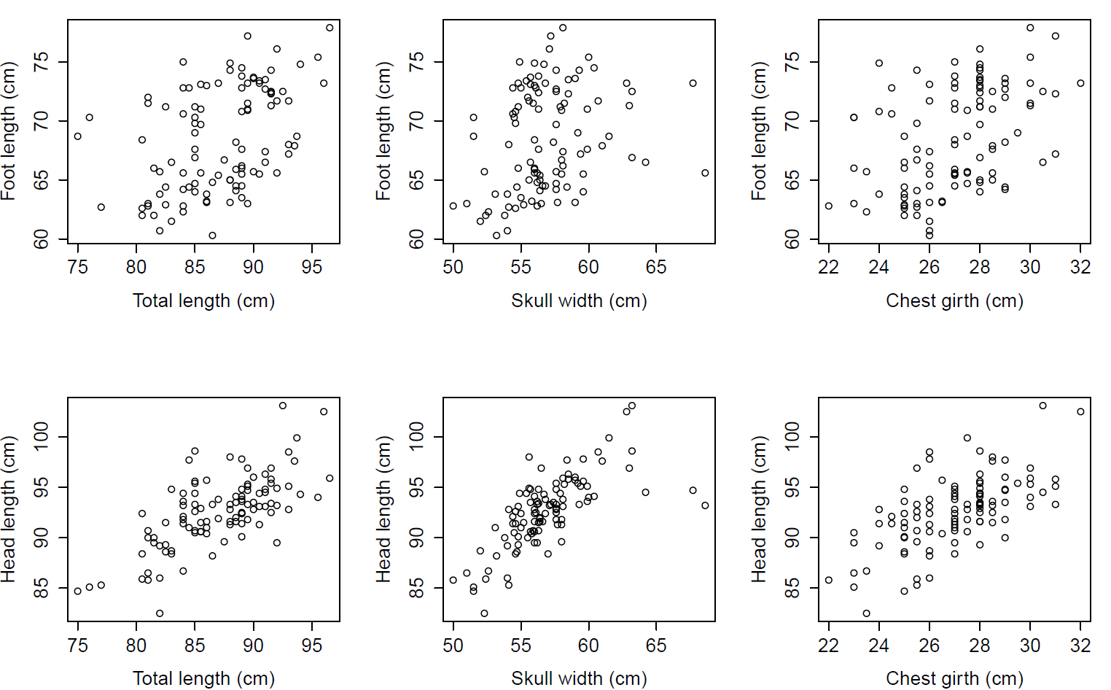
par(mfcol=c(2,3))

Slide 13

Edward Tufte’s rules
Maximize the data:ink ratio
Erase non-data ink
Increase the data density
Label the figures, avoid using legends
Tufte ER (2001) The visual display of quantitative information. 2nd ed. Graphics Press, Cheshire, Connecticut

Slide 14
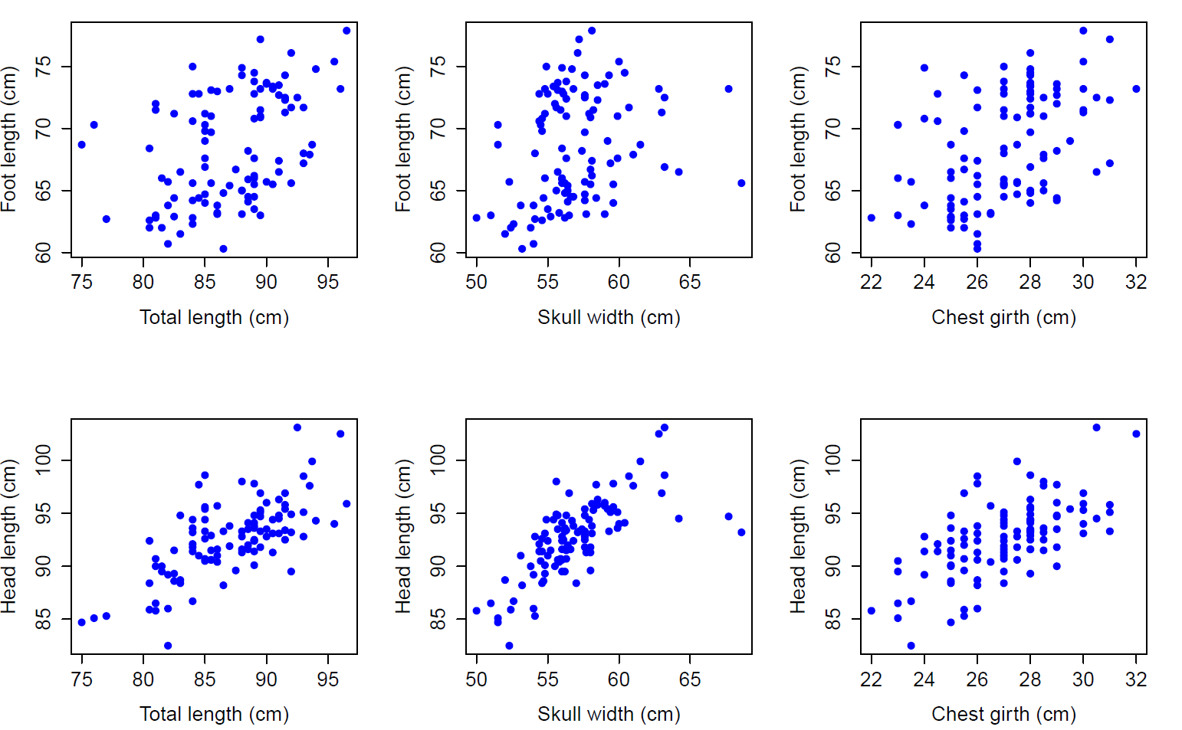
Data-ink is in blue

Slide 15
Redundant parts and wasted space

Slide 16
Changing the margins
When multiple plots are laid out, space can be optimized by modifying margins around each plot
par(mar = c(bottom, left, top, right))
Default is par(mar = c(5,4,4,2) + 0.1)
To change the margins around the entire figure, use this command:
par(oma = c(bottom, left, top, right))
Default is par(oma = c(0,0,0,0))

Slide 17
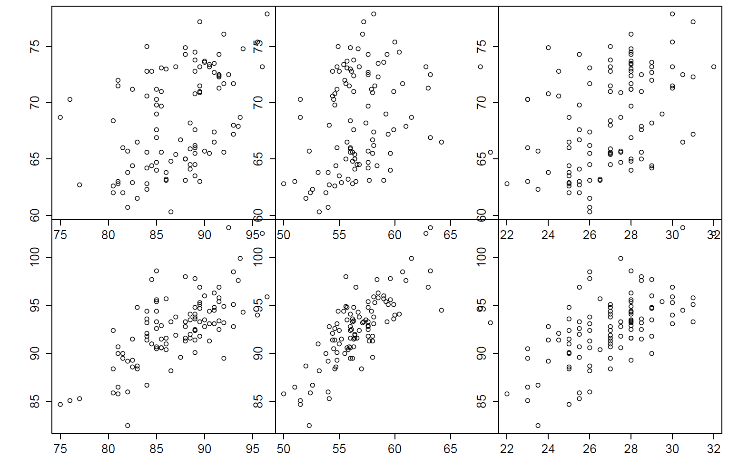
par(mar=c(0,0,0,0), oma=c(5,5,1,1))

Slide 18
Deleting axes, adding labels
To eliminate x or y axes or both, add to each individual plot
plot(..., xaxt="n", yaxt="n")
To add text to the outside of an individual plot, use a standalone command mtext after a single plot
mtext(text="Foot length (cm)", side=2, line=3)
To add text to the outside of multiple figures, use mtext with the outer=T option
mtext(text="Year", side=1, line=3, outer=T)
Values for side of the plot refer to 1=bottom, 2=left, 3=top, 4=right

Slide 19
Hands-on exercise 1 (starting code)
possum <- read.csv(file="possum.csv")
par(mfcol=c(2,3))
plot(possum$totlngth, possum$footlgth)
plot(possum$totlngth, possum$hdlngth)
plot(possum$skullw, possum$footlgth)
plot(possum$skullw, possum$hdlngth)
plot(possum$chest, possum$footlgth)
plot(possum$chest, possum$hdlngth)

Slide 20
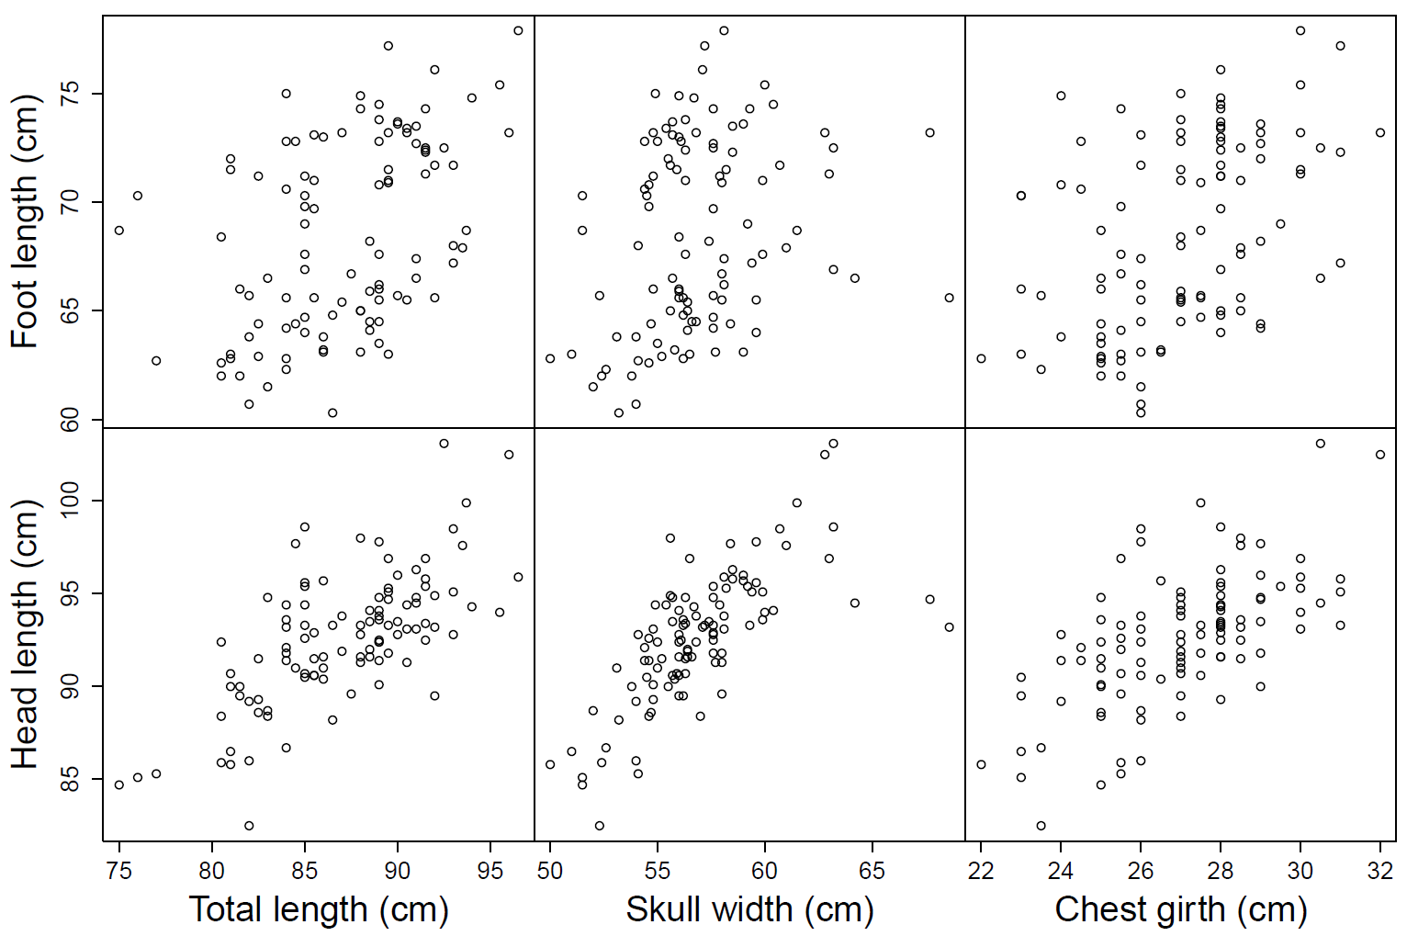
Modify the code using mar, oma, xaxt, yaxt, and mtext to create the plot below. Take it one step at a time! If you have time, beautify it further.

Slide 21
Customized layouts
The layout() function provides a much more flexible alternative to mfrow and mfcol settings
The primary difference is that layout() allows the creation of multiple figure regions of unequal sizes
The first argument is a matrix with the same number of rows and columns as in the figure layout
In the matrix are integer values determining the rows and columns each figure will occupy

Slide 22
layout()
layout(mat, widths, heights, ...)
mat a matrix giving the location of the next N figures on the output device. Each value in the matrix must be 0 or a positive integer. If N is the biggest number in the matrix, then the number 1, ..., N-1 must also appear in the matrix.
widths a vector of values for the widths of columns on the device.
heights a vector of values for the heights of rows on the device.

Slide 23
15 plots different widths and heights
mat <- matrix(c( 1, 2, 3, 4, 5,
6, 7, 8, 9,10,
11,12,13,14,15),
nrow=3, ncol=5, byrow=T)
layout(mat=mat, widths = c(1,3,5,1,3),
heights = c(2,2,1) )
layout.show(n=15)

Slide 24
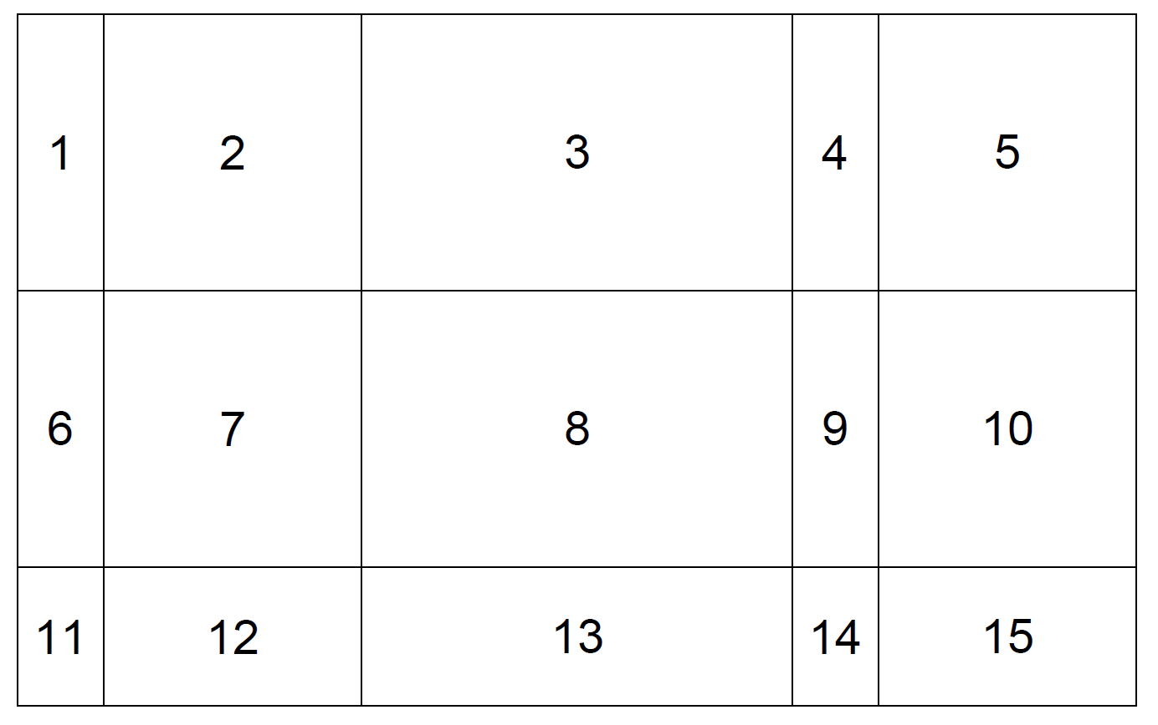
15 plots
1 2 3 4 5
6 7 8 9 10
11 12 13 14 15

Slide 25
Complex arrangement
mat <- matrix(c( 1, 1, 3, 4, 5,
1, 1, 3, 6, 7,
2, 2, 2, 2, 7),
nrow=3, ncol=5, byrow=T)
layout(mat=mat, widths = c(1,3,5,1,3),
heights = c(2,2,1) )
layout.show(n=7)

Slide 26
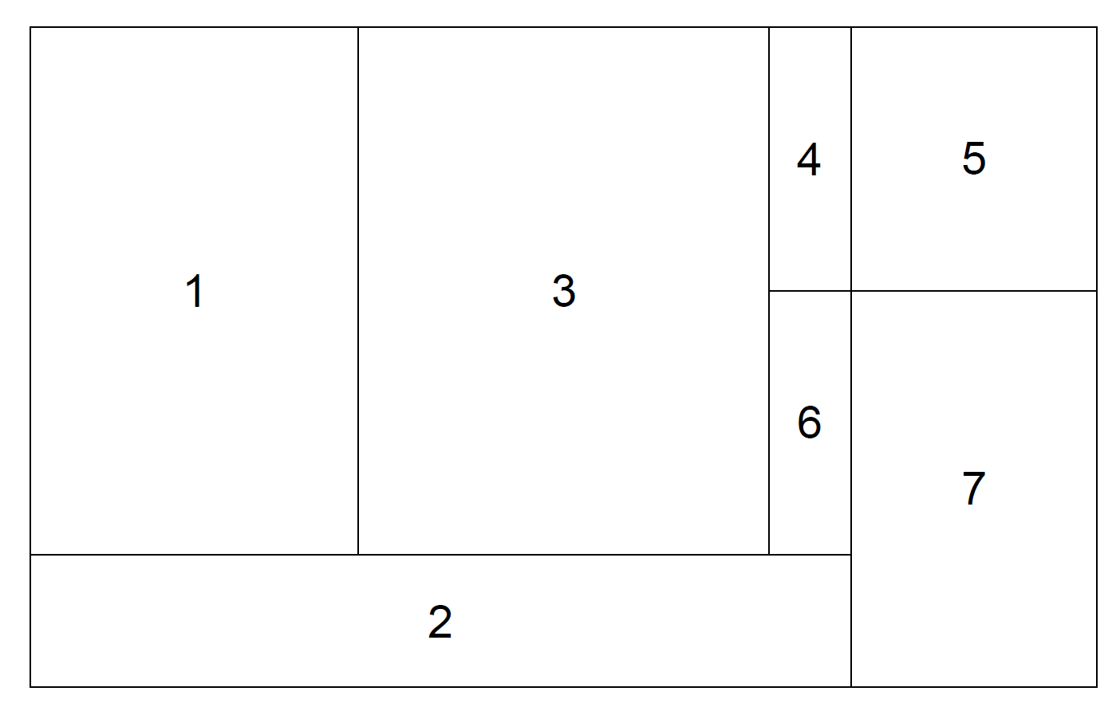
Complex arrangement
1 1 3 4 5
1 1 3 6 7
2 2 2 2 7

Slide 27
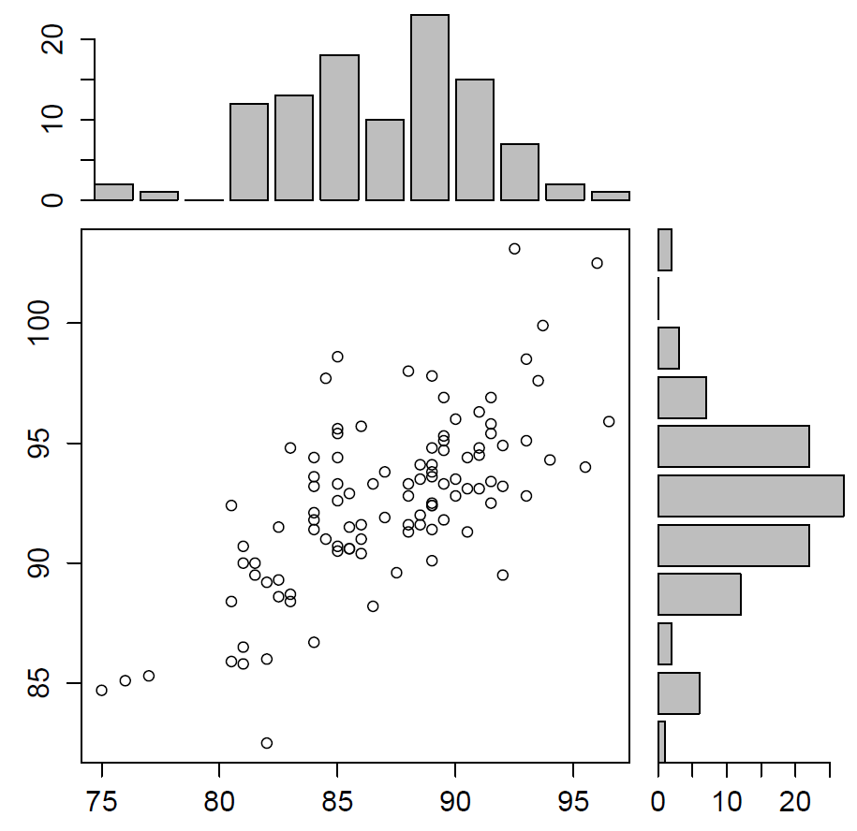
Zeros for empty plots
2 0
1 3

Slide 28
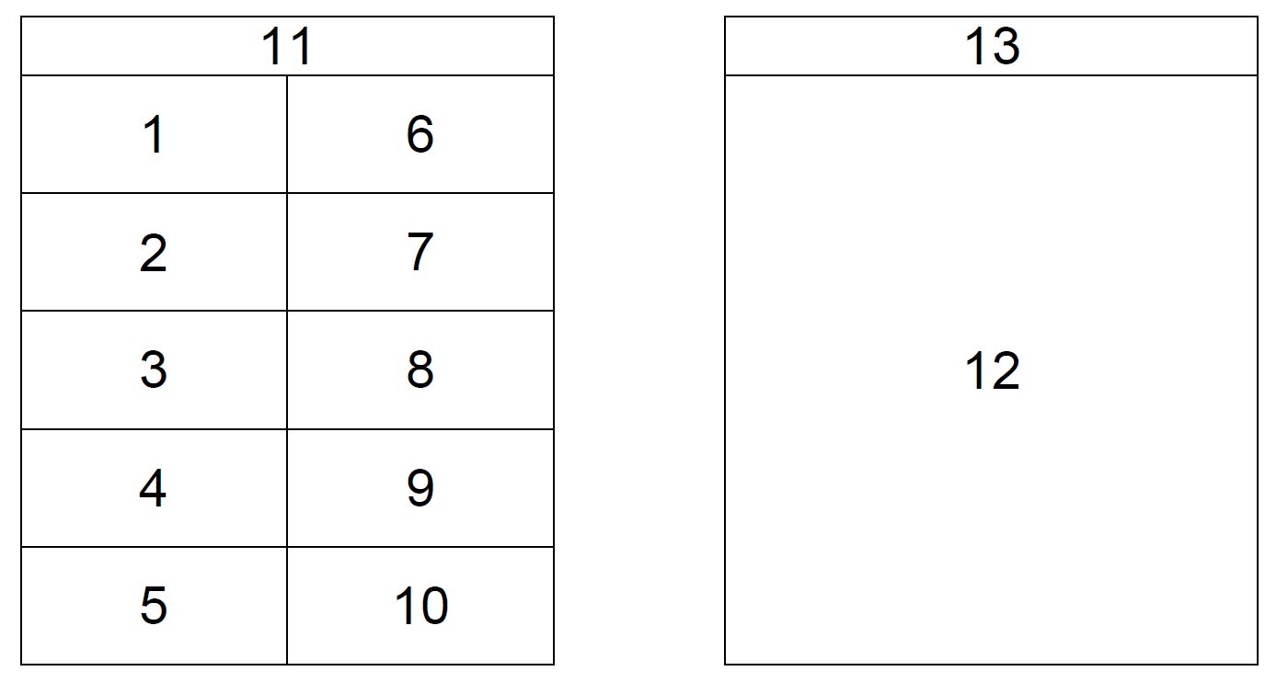
A published example
11 11 0 13
1 6 0 12
2 7 0 12
3 8 0 12
4 9 0 12
5 10 0 12

Slide 29
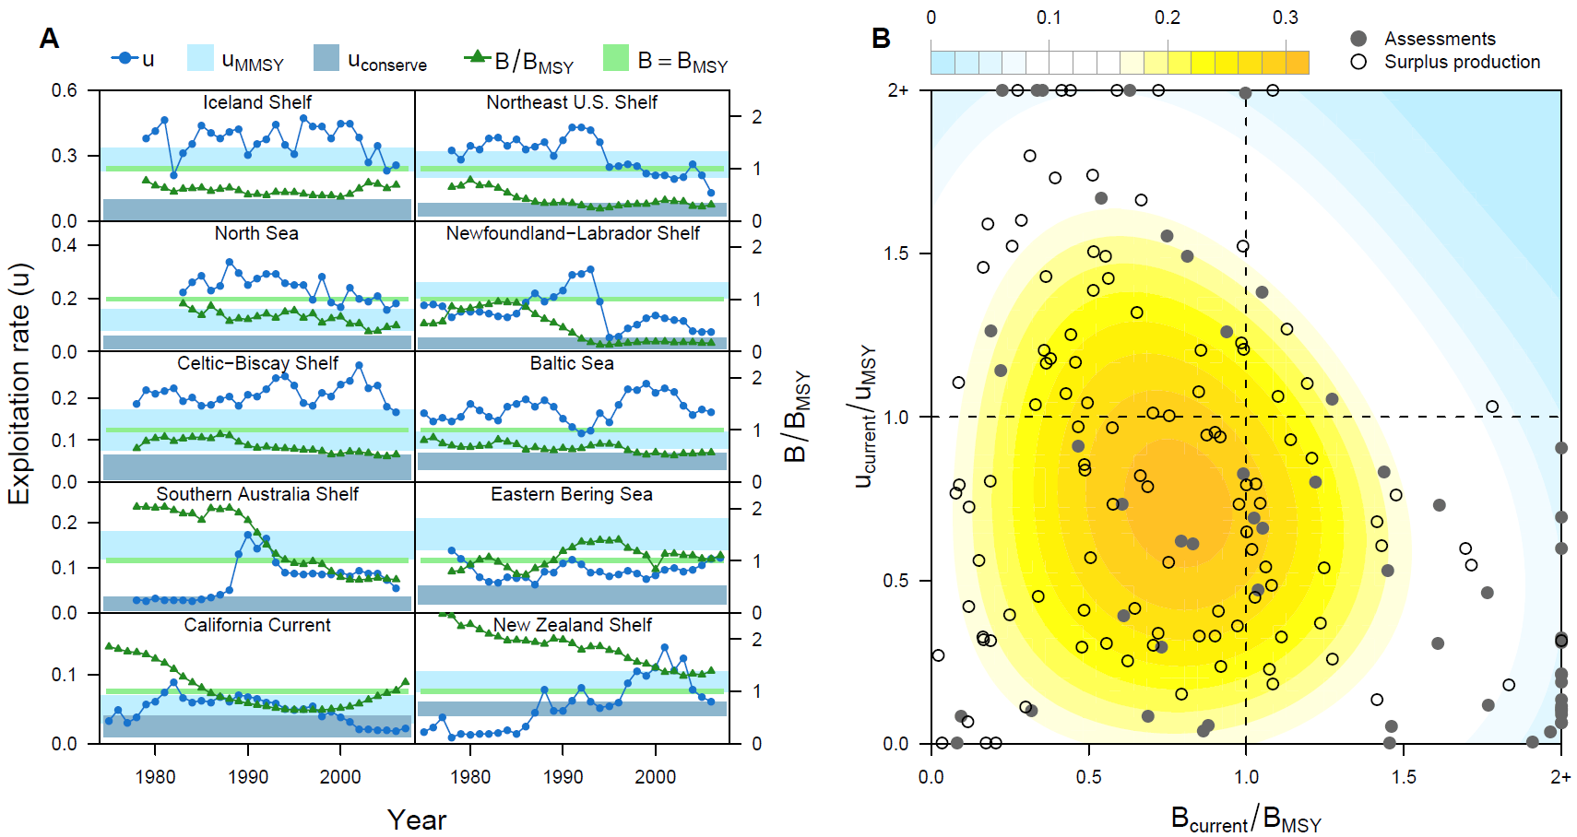
Then plot the figures...
11 11 0 13
1 6 0 12
2 7 0 12
3 8 0 12
4 9 0 12
5 10 0 12
Worm et al. (2009) Rebuilding global fisheries. Science 325:578-585

Slide 30
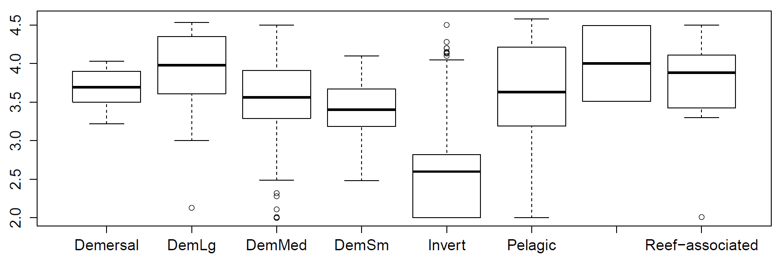
Boxplots
> catches <- read.csv("FAO catch.csv")
> names(catches)
[1] "ScientificName" "CommonName" "Lmax" "TL"
"Habitat" "MeanCatch"
> boxplot(catches$TL~catches$Habitat)
TL = trophic level (position in the food web)

Slide 31
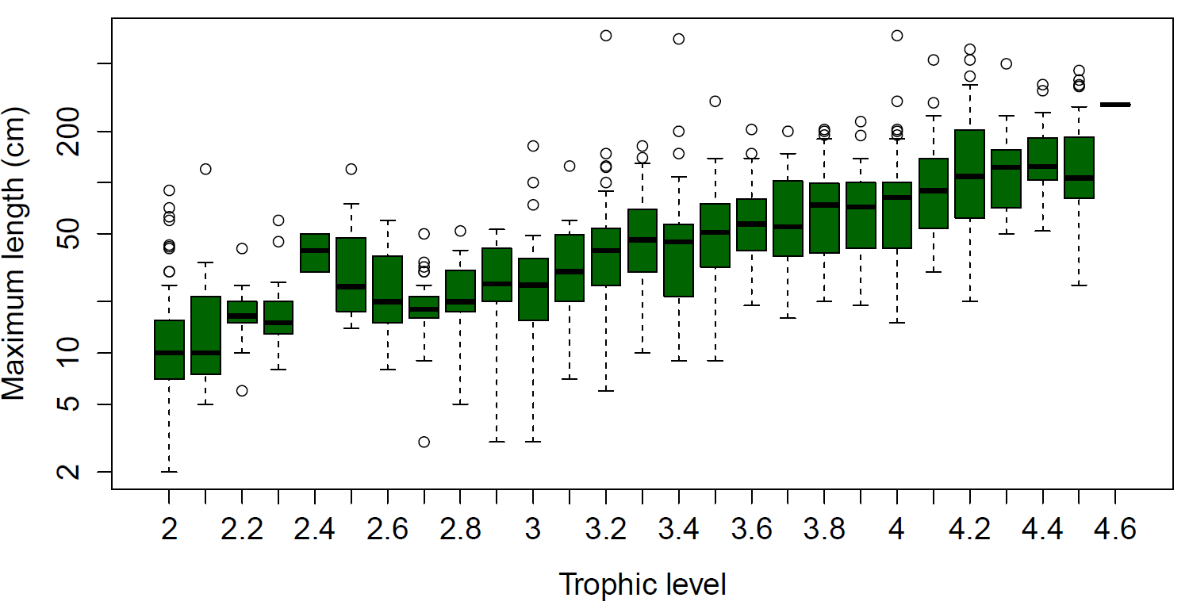
Round trophic levels to 1 decimal place
Log y-axis
> boxplot(catches$Lmax~round(catches$TL,1),log="y",
col="darkgreen", xlab="Trophic level",
ylab="Maximum length (cm)")

Slide 32
Barplots
Data should be a vector or a table
Row names and column names are used by default
> VADeaths
Rural Male Rural Female Urban Male Urban Female
50-54 11.7 8.7 15.4 8.4
55-59 18.1 11.7 24.3 13.6
60-64 26.9 20.3 37.0 19.3
65-69 41.0 30.9 54.6 35.1
70-74 66.0 54.3 71.1 50.0

Slide 33
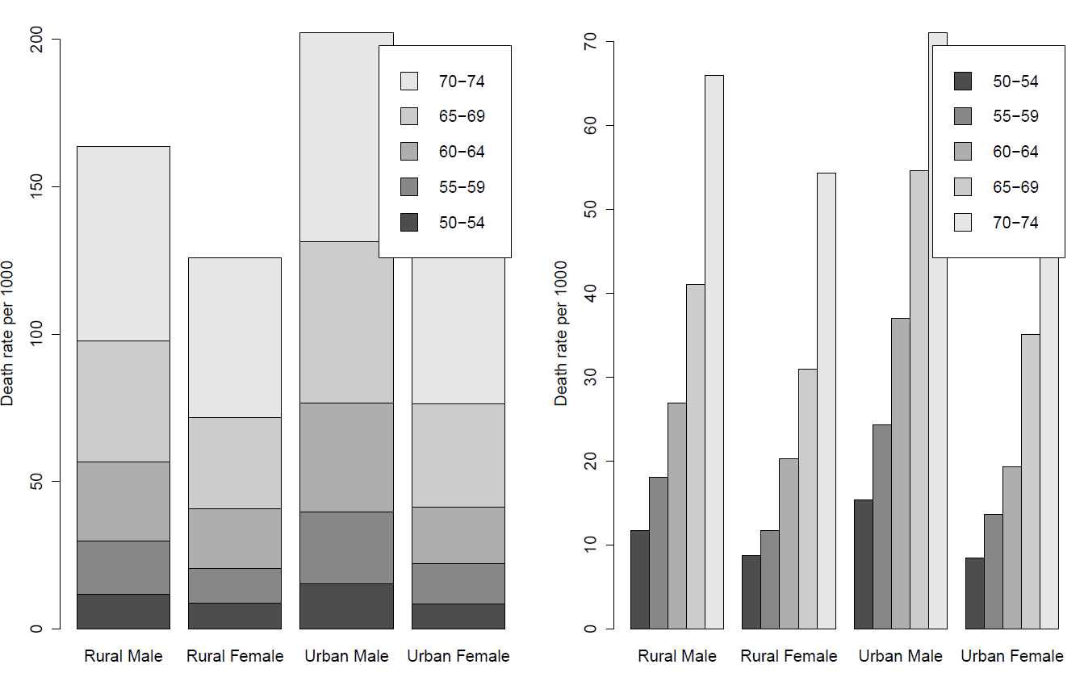
> barplot(VADeaths, legend=TRUE, ylab="Death rate")
> barplot(VADeaths, legend=TRUE, ylab="Death rate", beside=TRUE)

Slide 34
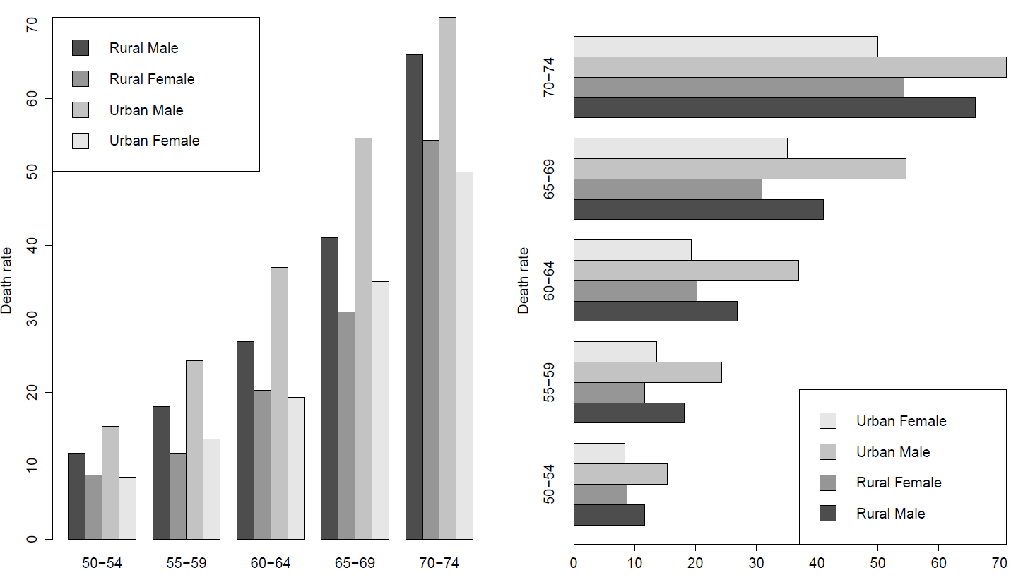
barplot(t(VADeaths), legend=TRUE, ylab="Death rate", beside=TRUE, args.legend=list(x="topleft"))
barplot(t(VADeaths), legend=TRUE, ylab="Death rate", beside=TRUE, args.legend=list(x="bottomright"), horiz=T)

Slide 35
Built-in iris dataset
We want to compare sepal length, sepal width, petal length, and petal width in the iris data
> iris
Sepal.Length Sepal.Width Petal.Length Petal.Width Species
1 5.1 3.5 1.4 0.2 setosa
2 4.9 3.0 1.4 0.2 setosa
3 4.7 3.2 1.3 0.2 setosa
...
51 7.0 3.2 4.7 1.4 versicolor
52 6.4 3.2 4.5 1.5 versicolor
...
101 6.3 3.3 6.0 2.5 virginica
102 5.8 2.7 5.1 1.9 virginica

Slide 36
In-class exercise 2a
Create a two-panel plot using mfrow
Panel 1 contains a boxplot comparing petal length among each of the three species in iris
Panel 2 contains a boxplot comparing petal width among each of the three species in iris
See next slide for plot you are aiming to produce

Slide 37
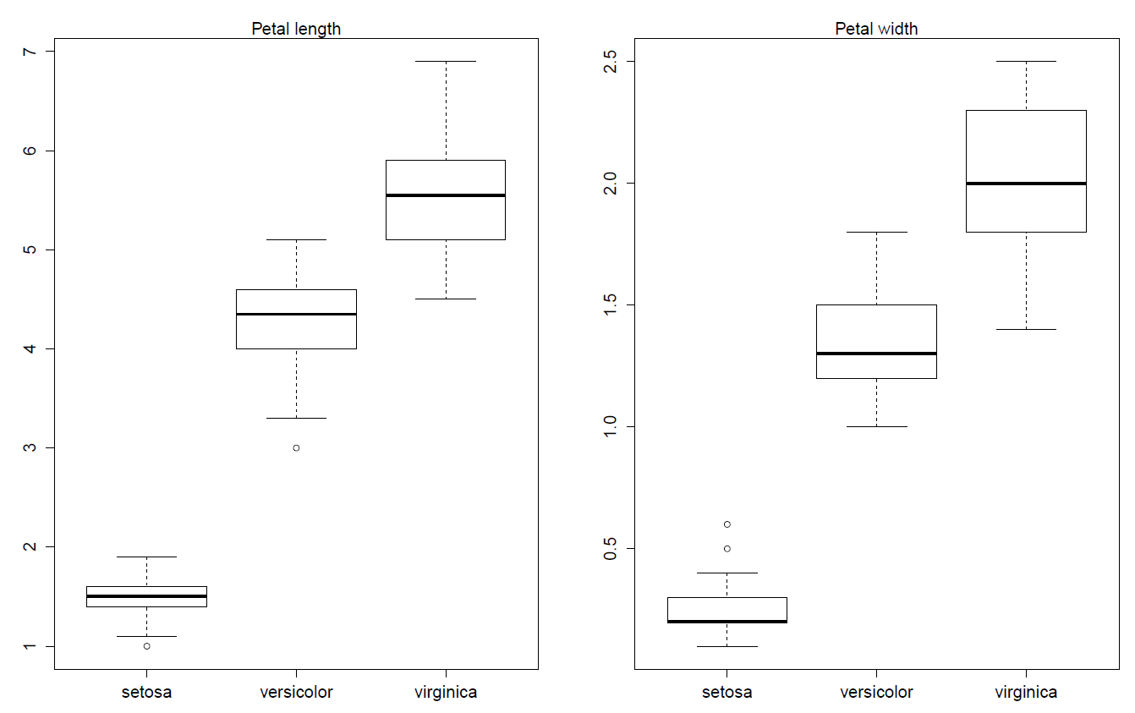

Slide 38
For all species combined...
Now we want a boxplot comparing petal and sepal measurements for all species combined
But the iris dataset is in the wrong format
We want:
> newiris
measure data
1 Sepal.Length 5.1
2 Sepal.Length 4.9
...
151 Sepal.Width 3.5
152 Sepal.Width 3.0
...
301 Petal.Length 1.4
302 Petal.Length 1.4
...
451 Petal.Width 0.2
452 Petal.Width 0.2

Slide 39
Hands-on exercise 2b
Step 1: create a vector called measure, containing 150 copies of "Petal.Length", followed by 150 copies of "Sepal.Length", etc.
Step 2: create a vector data containing the data in iris$Petal.Length, followed by the data in iris$Sepal.Length, etc.
Step 3: create a data frame newiris using data.frame to combine measure and data
Step 4: use boxplot to compare data as a function of measure in newiris (see next slide)

Slide 40
